Slide 1
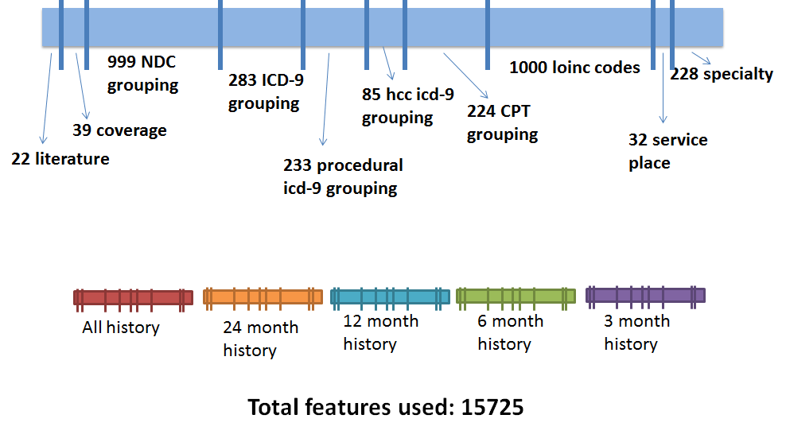
1000x8
LAB Features
Early Prediction of Type II Diabetes from Administrative
Medical Records
Narges Razavian, Rahul G. Krishnan, David Sontag
Courant Institute of Mathematical Sciences, New York University, New York City
Project Goals
Features
Prediction and analysis of disease trajectories in patients for:
Personalized disease intervention discovery
New medical insight in disease mechanisms
Population policy design
In this poster: Early Prediction of Type II Diabetes
Data
Experimental Results I
4.08 million patients’ health-care claim records over [2005 to 2013]
Socio-economic Data (1.9 million patients)
L1 regularized Logistic Regression | Validation Set Area Under the Curve
Baseline (22 risk factors used in Medical Literature) | 0.709
Extensive Features (33435 Features) | 0.751
Eligibility
records
Medication
prescriptions
Medical/
Encounter Claim data
Lab tests
Methodology
Experimental Results II
Data Representation: Features from patient records up to time T
Diabetes Label: If patient has diabetes onset between T and T+W
Models
L1-Regularized Logistic Regression
Decision Tree
Gradient Boosted Decision Tree
Current Parameters
T=2011, W = 24 months
Training set: 437K cases, 4% positive
Validation set: 237K cases,
4% positive
Focusing on sensitivity for patients with highest
predicted probability of developing diabetes
Nonlinear Models: Decision Trees and Gradient
Boosted Decision Trees
Model / Trained on Patients with P_{logit}(diabetes=1)>0.57 | Validation Set AUC (30K patients 10% positive)
Best L1-regularized Logistic Regression Model | 0.5903
Best Decision Tree Model Feature Selection via L1 regularized Logit | 0.6125
Best Gradient Boosted Decision Tree Model Feature Selection via L1 regularized Logit | 0.6322
Discussions and Future Work
Features from medical records improve the prediction
accuracy compared to existing risk factors in literature
Nonlinear models improve prediction specificity for
high risk patients
Nontrivial interventional features discovered suggest
further casual inference analysis

